Slide 1

G2M Cab-industry investment Study
Virtual Internship
21-sept-2022

Slide 2
G2M Cab-industry investment Study
Business Problem:
Deciding on the best investment for XYZ company in the cab industry. The two companies in question are "yellow cab" & "pink cab".
Objective :
Translate data into insights to help XYZ firm decide whether to invest in “Yellow Cab” or “Pink Cab”.
Case study analysis steps:
Data preparation and wrangling
Data Analysis
Business Recommendations

Slide 3
Data preparation and wrangling
Errant data handling
Datasets merge
Data Cleaning
Data Processing into new features
Data description after processing & Assumptions
19 Features(8 derived features)
Timeframe of the data: 2016-01-31 to 2018-12-31
Total data points :359392
5 data sets
Data Assumptions:
Any ride where the company is not mentioned is not helpful in making final decision.
Data provided beyond the span of 3 years (2016-01-31 to 2018-12-31 ) is not considered.
The market un-utilized by both companies is up-for-grabs (i.e. there are no other competitors)
The cost of a ride is based on kms only, the rest of the charged amount is the profit per ride.
XYZ is interested in the company with biggest growth potential, not current market share.

Slide 4
Data Analysis
Roadmap
Market status quo
Number of rides
Number of costumers
Geography-centric analysis
Dominance among users per city
Mean profit
Rate of rides per city
Profit per city
Dates-centric analysis
Demography-centric analysis
Women
Older
Rich
Trends in dates
Effect of weekends/holidays
Loyality of costumers
Time based analysis
Trends in dates
Effect of weekends/holidays
Loyality of costumers
Change-in-profit based analysis
per month
per city & year

Slide 5
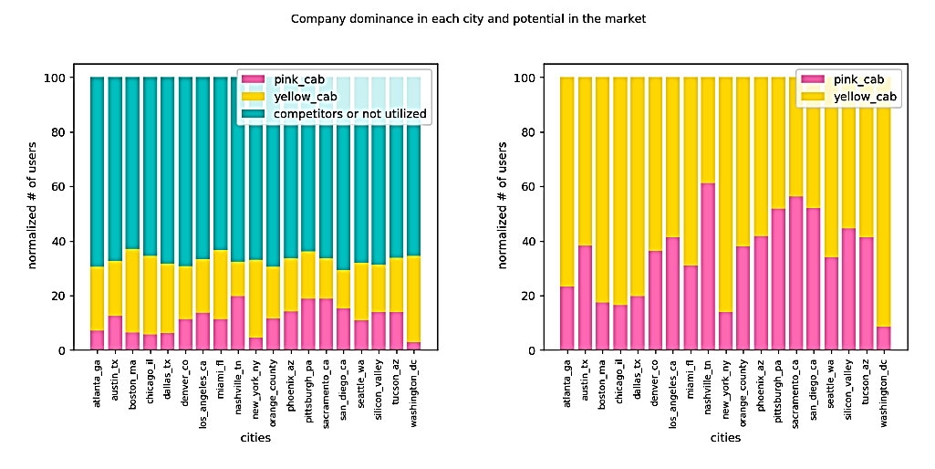
Excellent investment opportunity!
This unutilized market represent the prospect of XYZ’s investment.

Slide 6
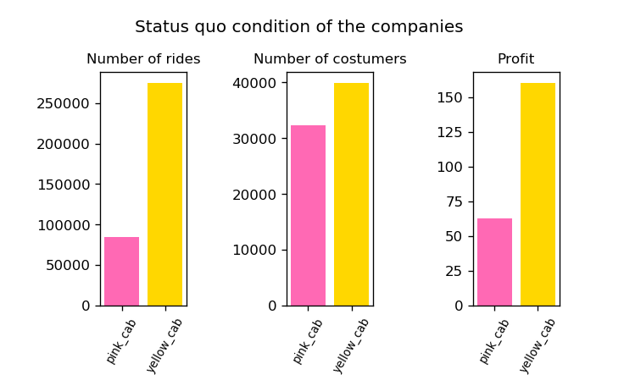

Market Status Quo
Number of rides, Number of costumers, Mean profit
“Yellow Cab” has a better hold on the market at the moment.

Slide 7
Geographical-based analysis
Dominance among users per city
Assume that the number of users are the sum of the two companies users.
“Yellow Cab” has more users in all cities except Nashville, Sacramento, San Diego and Pittsburgh

Slide 8
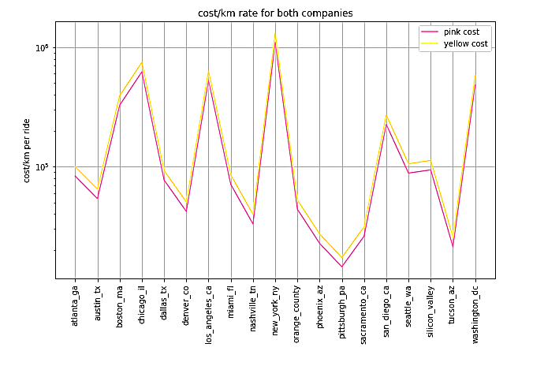
Geographical-based analysis
Rate of rides per city
Assume that the rate depends only on Kms covered
Both companies have the same rate/km with a slightly higher cost/km to “Yellow Cab”.
Cost/km has surges in cities that are central in the US.
NY -> capital
Washington -> political capital
LA and San diego -> touristic

Slide 9
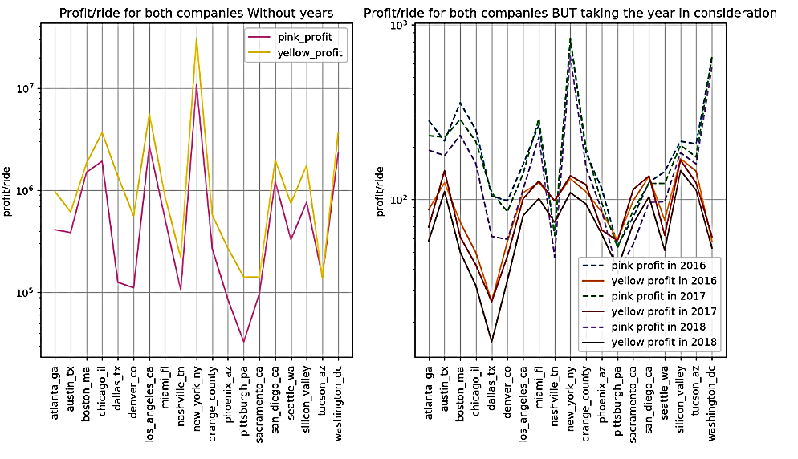
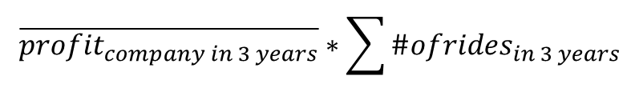
Geographical-based analysis
Profit/ride per city
Scale profit/ride to the total the total number of rides over the 3 years for each company .
“Yellow Cab” is more profitable in all the cities.
If both companies charge the same, Why is yellow making more profit ?
Because it is more popular among users
$$\overline{profit_{company in 3 years}}∗\sum{\#ofrides_{in 3 years}}$$

Slide 10
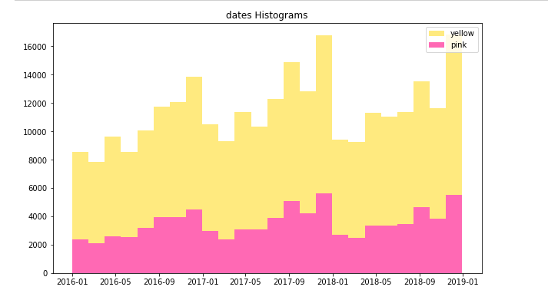
Time based analysis
Seasonality in number of rides
Yearly seasonality; same trend of data every year.
A surge around December (Christmas holidays) and a dip in winter months.
Zooming in per month, there’s a surge 2 consecutive days every week

Slide 11
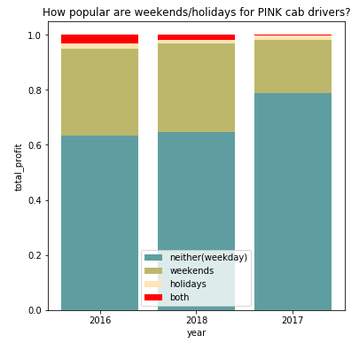
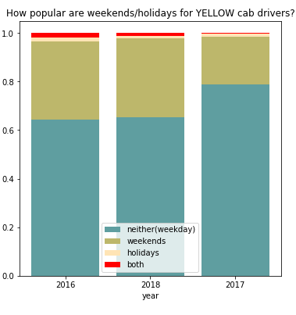
Time based analysis
Contribution of weekends/holidays to profit
Divide dates into
Working day
Weekend
Holiday
Both
With more time on their hands, people move around more on weekends.
The holidays are a slow season for cabs.

Slide 12
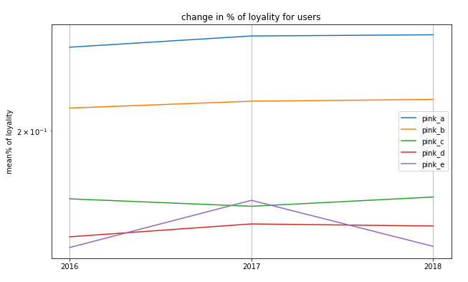
Time based analysis
Loyalty of costumers
Divide loyal costumers to a company into groups:
GrpA → 5<rides <15
GrpB → 15<rides <25
GrpC → 25<rides <35
GrpD → 35<rides <45
GrpE → >45 rides
Both companies can retain costumers’ loyalty over the years

Slide 13
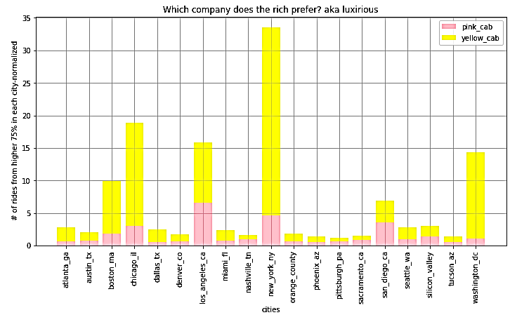
Demography-specific based analysis
Rich
Filter the riders with the higher 75% income per city.
The rich use “Yellow Cab” more frequently.
There's a strong correlation between the number of rides the rich take and the city in question.
Higher population= Congested Traffic + Scarcity of parking spots= No private cars
The rich -especially- prefer cabs over the subway

Slide 14
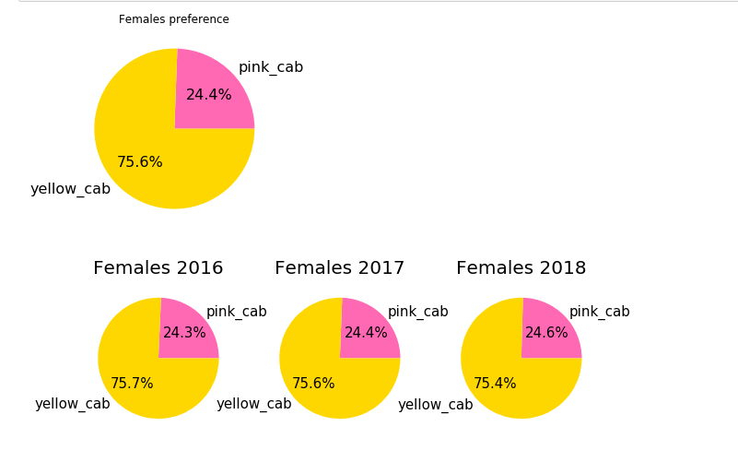
Demography-specific based analysis
Women
Women’s preference = Which company provides safer rides ?

Slide 15
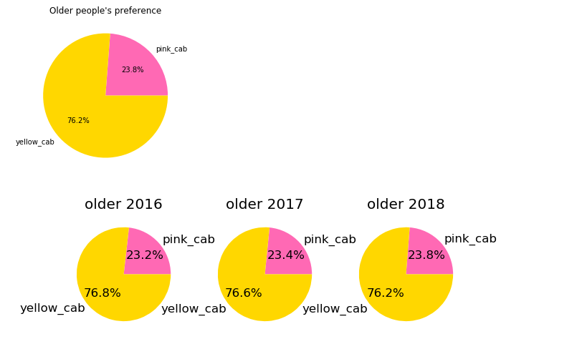
Demography-specific based analysis
Older
Age group > 45 years
Usually overlooked when considering new services.
Elderly’s preference = Which company provides an easier-to-use UI ?

Slide 16
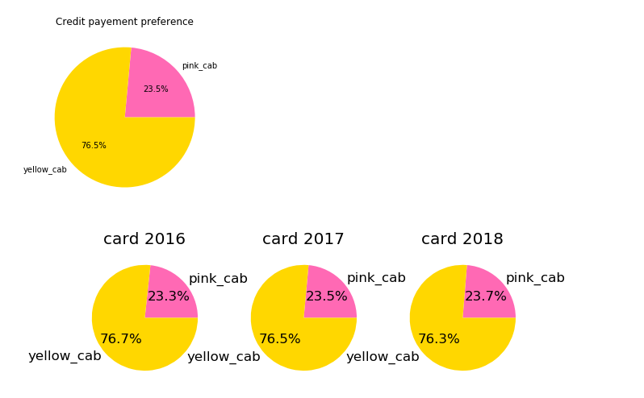
Demography-specific based analysis
Credit card users
Credit card user preference= Which company has a more reliable app with less breach-of-data chances ?

Slide 17
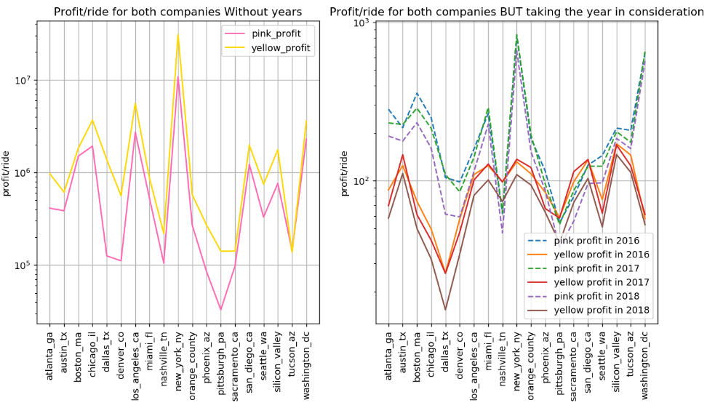
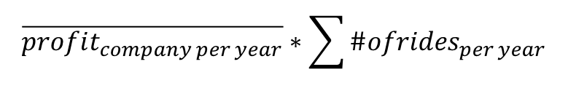
Change-in-profit based analysis
Profit scaled to total city rides
Similar to Profit/ride per city in geographical-based analysis, but in this case, scaled to each year's rides separately.
Profit/ride of “Pink Cab” is better per year.
$$\overline{profit_{company per year}}∗\sum{\#ofrides_{per year}}$$
The cab market is slowing down; the profits of both companies in 2018 is less relative to their profits in 2016!

Slide 18
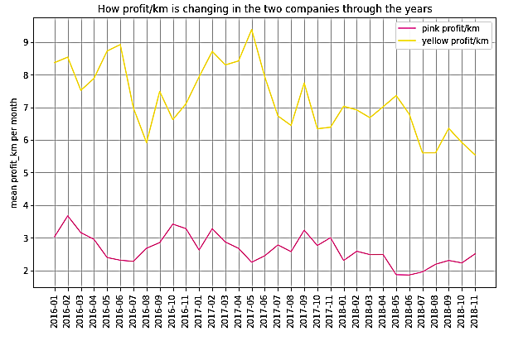
Change-in-profit based analysis
Change in profit over 36 months
This analysis confirms that the mean profit of “Yellow Cab” is higher than that of “Pink Cab”.
Both mean profits are deteriorating!

Slide 19
Business Recommendation
Should XYZ invest in Yellow cab company or Red cab company?
Although “pink cab” is promising, on the short term it’s wiser to invest in “yellow cab” because of the current market state.

Slide 20
Business Recommendation
Observations to why “Yellow Cab” is more established
The status quo of the market favors “Yellow Cab” in number of costumers, number of rides and mean profit.
“Yellow Cab” is more dominant in all cities except Nashville, Sacramento, San Diego and Pittsburgh.
Rate/ride of both companies are the same for each city with a slightly higher rate for “Yellow Cab” and it still retain the loyalty of its costumers.
Both companies retain the loyalty of their costumers over the 3 years so you might as well invest in the company that reaches more users.
75% of the reported costumers who were women used yellow cab
75% of older users use yellow cab
75% of credit card users use yellow cab
Costumers with higher incomes use yellow cab more frequently

Slide 21
Business Recommendation
Observations to why “Pink Cab” is promising
Analysis where the data is divided into smaller time intervals show that “Pink Cab” is slowly improving.
24.3 % of women costumers by 2017 become 24.6 % by 2019
Similarly elderlies are becoming more acquainted with “Pink Cab” and their percentage improve from 23.2% to 23.8%
Credit card users % is improving gradually as well, going from 23.3% to 23.7% which suggests gaining credibility
Pink cab offers users a slightly lower cost/km which might attract more users in the future
When profits/rides of both companies are scaled to a constant number of rides (the sum) per year, it’s shown that “Pink Cab” perform better.

Slide 22
Business Recommendation
Observations to the market state
The analysis change in profit over 36 months showed that both companies had less profit_km in 2018 than they did in 2016.
The conclusion is further supported when profit scaled to total city rides confirmed that each company perform worse in 2018 than they did in 2016
This suggests that on the short-term, it’s not smart to take risks and it better to take the safest bet.

Slide 23
Business Recommendation
Suggestions to retain and grow yellow cab’s market share
To retain Women market :
Make sure you provide safer rides through features such as tracking option, SOS service and female drivers
To retain Elderlies market:
Provide a phone call alternative to the traditional use of apps to order a cab.
To retain credit card users:
Highlight how sturdy the application is against data breaching and hacking. This will allow users to register their payment info on the app.
Offer a decreased cost/km in the four cities where pink cab is ahead: Nashville, Sacramento, San Diego and Pittsburgh
Offer more luxurious rides in the cities that has high number of wealthy costumers such as New York, Washington, San Diego and LA
Offer discounted rates on weekends. It looks like both companies have a big share of their profit caused by rides on weekends. Having such discounts will attract other companies users.

Slide 24
Thank You

